Slide 1
DESIGN AND OPTIMISATION OF SINGLE MOSFET DRAM CONSISTING OF TRENCH CAPACITANCE USING SILVACO ATHENA PROCESS SIMULATOR
Under The Guidance
Of
Dr. Angsuman Sarkar
By
Maitri Misra
Sayandip De
Rajib Paul
Tanmay Das

Slide 2
AIMS & OBJECTIVES
Design of 1T DRAM consisting of trench capacitor using SILVACO ATHENA process simulator.
To study the effect of variation of MOSFET parameters on the characteristics of single mosfet DRAM consisting of trench capacitor using SILVACO ATLAS device simulator.

Slide 3
TABLE OF CONTENTS
TOPIC PAGE NO.
Necessary Background of Process Simulation 4
Introduction to Silvaco process simulator: Athena 5
Introduction to Silvaco device simulator: Atlas 10
Process flow Description of a MOSFET 11
Summary of work done in 7th Sem 27
Work to be done in 8th Sem 28
References 29

Slide 4
PROCESS SIMULATION
Process simulation is a model-based representation of chemical, physical, biological, and other technical processes and unit operations in software.
Process simulation is used for the design,development,analysis,and optimization of technical processes.
Basic prerequisites are a thorough knowledge of chemical and physical properties of pure components and mixtures, of reactions, and of mathematical models which, in combination, allow the calculation of a process in computers.

Slide 5
SILVACO PROCESS SIMULATOR : ATHENA
ATHENA is a simulator that provides general capabilities for numerical, physically-based, two-dimensional simulation of semiconductor processing. It has a modular architecture with the following licensable tools and extensions:
ATHENA
SSUPREM4
ELITE
OPTOLITH

Slide 6
ATHENA FEATURES AND CAPABILITIES
FEATURES | CAPABILITIES
DEPOSITION | Conformal deposition model. • CVD model. • Surface diffusion/migration effects. • User-definable models.
DEVELOPMENT | Five different photoresist development models.

Slide 7
DIFFUSION | Impurity diffusion in general 2D structures including diffusion in all material layers. • Oxidation enhanced/retarded diffusion effects. • Rapid thermal annealing. • Models simultaneous material reflow and impurity diffusion.
EPITAXY | • 2D epitaxy simulation including auto-doping.

Slide 8
ETCH | • Extensive geometric etch capability. • Wet etching with isotropic profile advance. • RIE model that combines isotropic and directional etch components. • Monte Carlo plasma etching.
IMPLANTATION | • Extended low energy and high energy implant parameter tables.

Slide 9
OXIDATION | • Compressible and viscous stress dependent models. • Separate rate coefficients for silicon and polysilicon materials. • HCL and pressure-enhanced oxidation models. • Impurity concentration dependent effects. • Ability to simulate the oxidation of structures with deep trenches, undercuts, and ONO layers.

Slide 10
SILVACO DEVICE SIMULATOR:ATLAS
Atlas provides general capabilities for physically-based two (2D) and three-dimensional (3D) simulation of semiconductor devices.
Atlas is designed to be used with the VWF Interactive Tools. The VWF Interactive Tools are DeckBuild, TonyPlot, DevEdit, MaskViews, and Optimizer.
Atlas is supplied with numerous examples that can be accessed through DeckBuild.

Slide 11
DESCRIPTION OF FABRICATION OF A MOSFET DEVICE
In the following set of slides, a set of statements and the accompanying intermediate results are given in the process of fabrication of a MOSFET device using ATHENA.
Electrical characterization is performed afterwards using ATLAS.

Slide 12
STEPS OF FABRICATION
MESH SETUP
go athena
#
line x loc=0.0 spac=0.1
line x loc=0.2 spac=0.006
line x loc=0.4 spac=0.006
line x loc=0.6 spac=0.01
#
line y loc=0.0 spac=0.002
line y loc=0.2 spac=0.005
line y loc=0.5 spac=0.05
line y loc=0.8 spac=0.15
#
init orientation=100 c.phos=1e14 space.mul=2
structure outf=structure_1.str

Slide 13
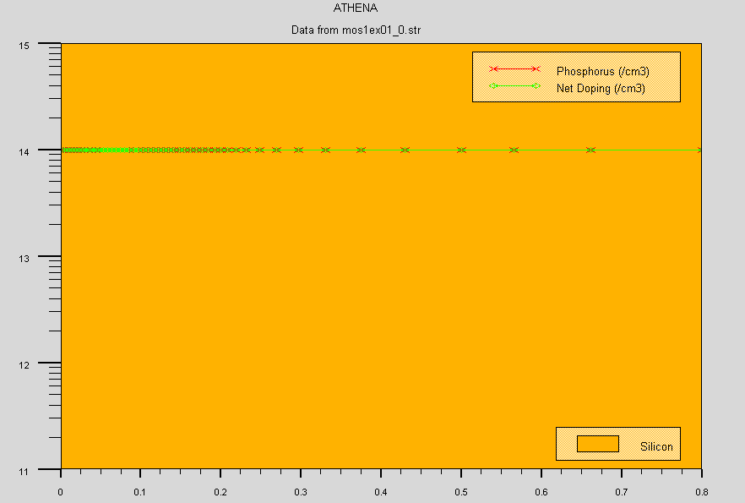

Slide 14
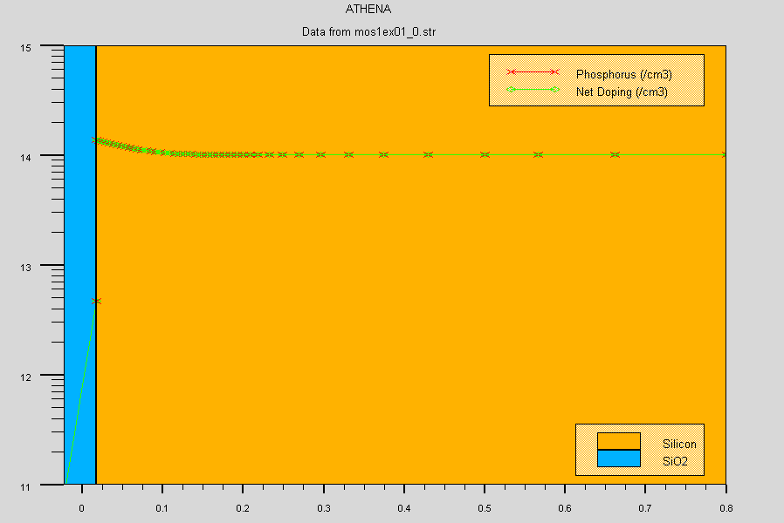
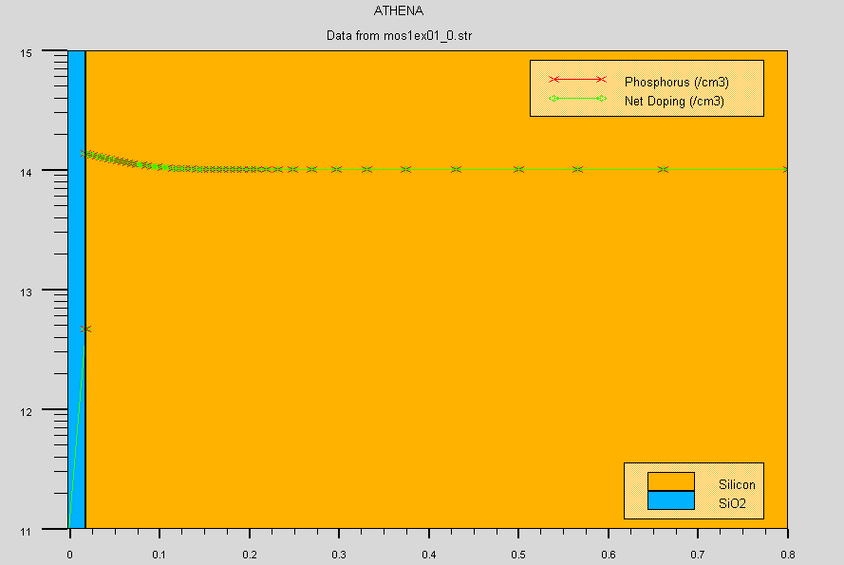
OXIDE GROWTH AND ETCHING
#pwell formation including masking off of the nwell
diffus time=30 temp=1000 dryo2 press=1.00 hcl=3
structure outf=structure_2.str
#
etch oxide thick=0.02
structure outf=structure_3.str

Slide 15
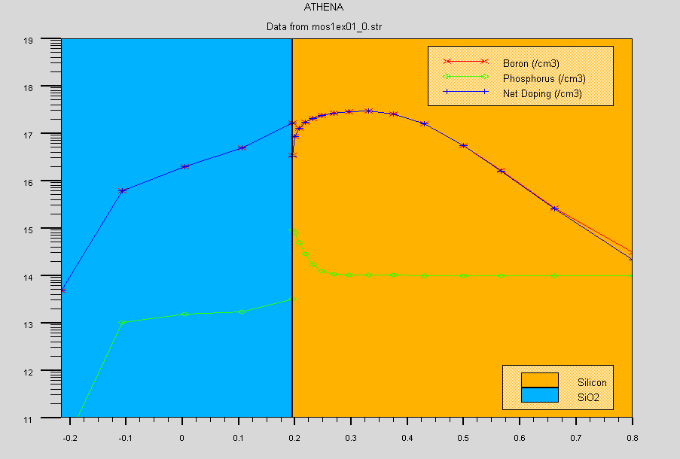
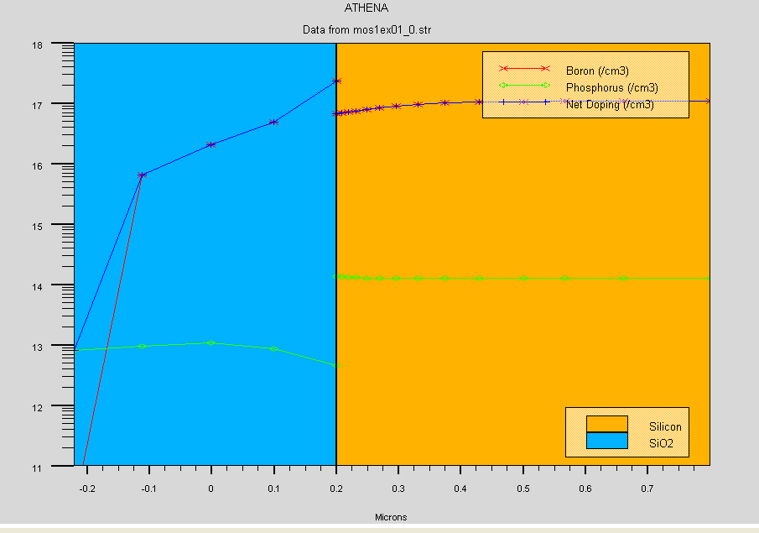
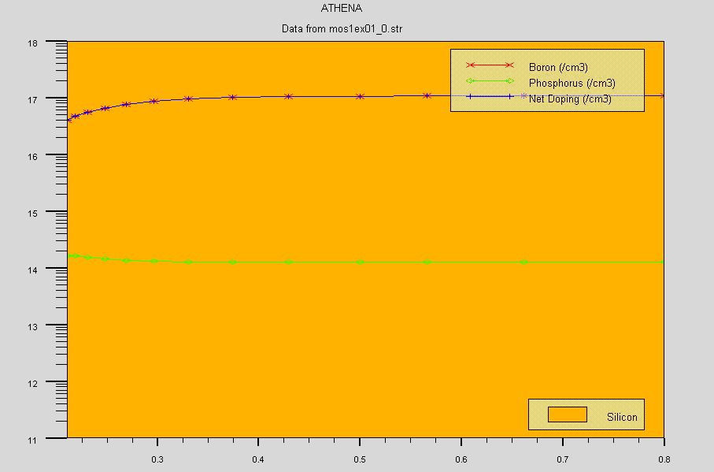
P-WELL FORMATION AND OXIDE GROWTH AND ETCHING
# P-well Implant
implant boron dose=8e12 energy=100 pears
diffus temp=950 time=100 weto2 hcl=3
structure outf=structure_4.str
#
# N-well implant not shown -
#
# welldrive starts here
diffus time=50 temp=1000 t.rate=4.000 dryo2 press=0.10 hcl=3
diffus time=220 temp=1200 nitro press=1
diffus time=90 temp=1200 t.rate=-4.444 nitro press=1
structure outf=structure_5.str
#
etch oxide all
#
# sacrificial "cleaning" oxide
diffus time=20 temp=1000 dryo2 press=1 hcl=3
#
etch oxide all
#
structure outf=structure_61.str

Slide 16
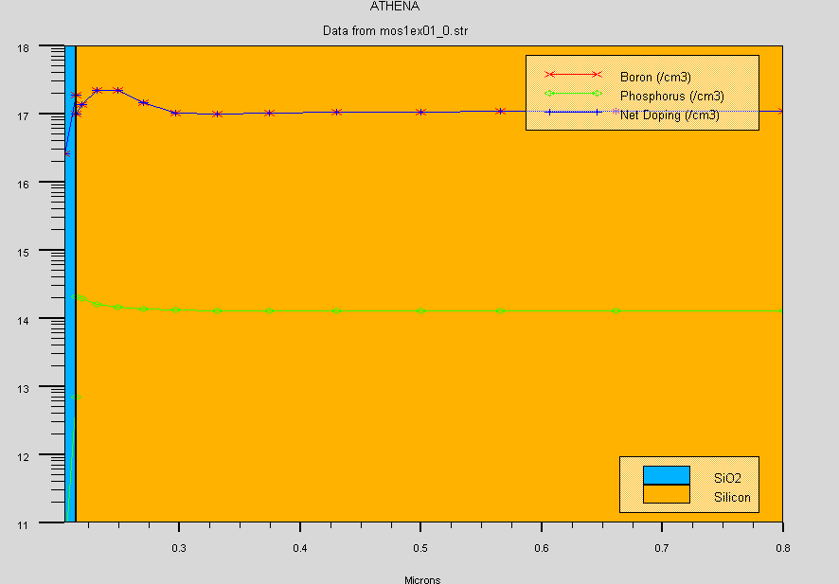
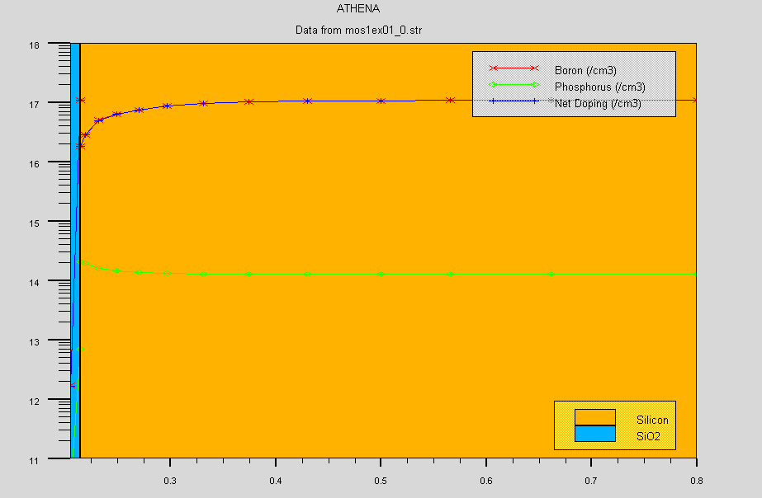
GATE OXIDE IMPALNT AND VT-ADJUST IMPLANT
# gate oxide grown here:-
diffus time=11 temp=925 dryo2 press=1.00 hcl=3
structure outf=structure_6.str
# extract gate oxide thickness
extract name="gateox" thickness oxide mat.occno=1 x.val=0.50
#
# vt adjust implant
implant boron dose=9.5e11 energy=10 pearson
structure outf=structure_7.str

Slide 17
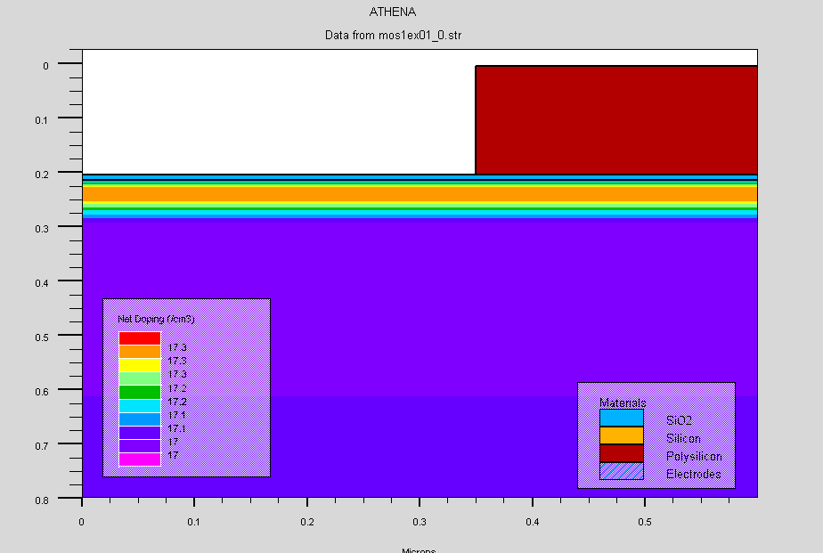
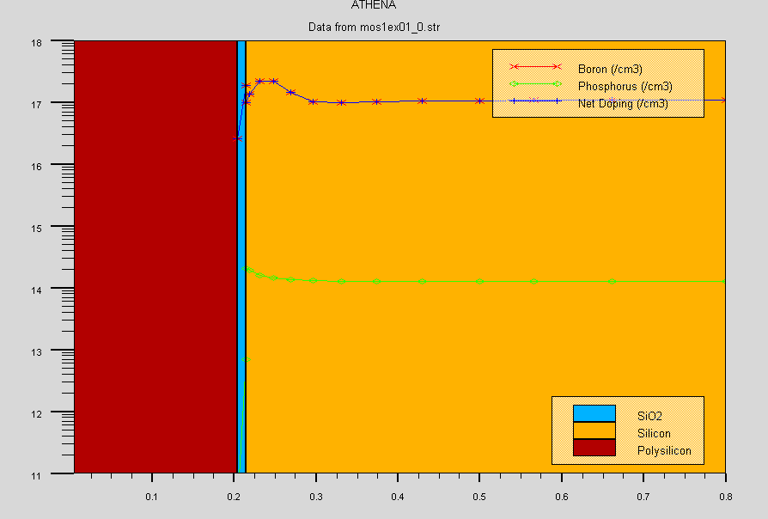
POLYSILICON DEPOSITION AND ETCHING
# Polysilicon deposition
depo poly thick=0.2 divi=10
structure outf=structure_8.str
#
# from now on the situation is 2-D
#
etch poly left p1.x=0.35
structure outf=structure_9.str

Slide 18
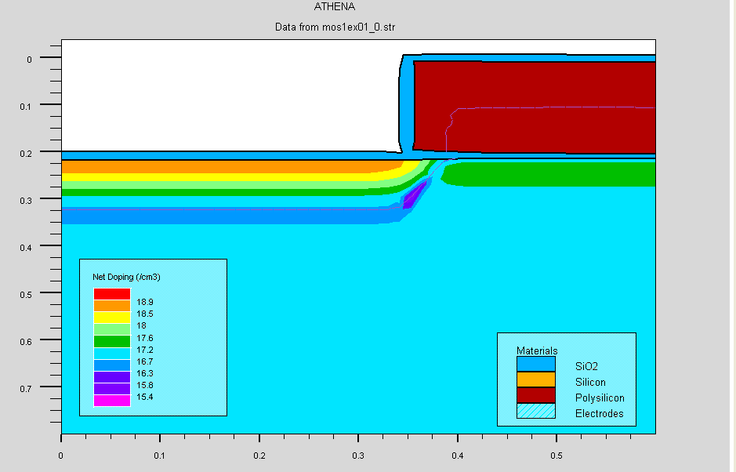
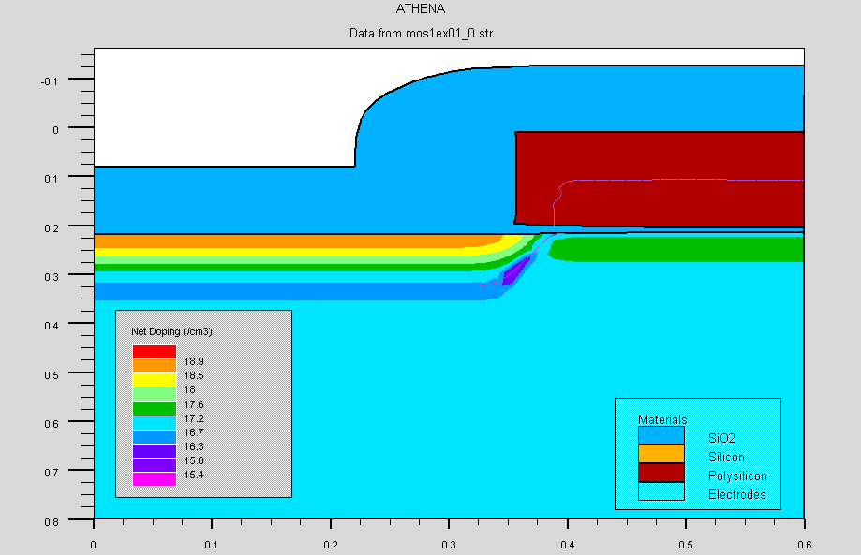
N+-REGIONS FORMATION AND FIELD OXIDE GROWTH
method fermi compress
diffuse time=3 temp=900 weto2 press=1.0
# implant phosphor dose=3.0e13 energy=20 pearson
structure outf=structure_10.str
#
depo oxide thick=0.120 divisions=8
structure outf=structure_11.str
#
etch oxide dry thick=0.120

Slide 19
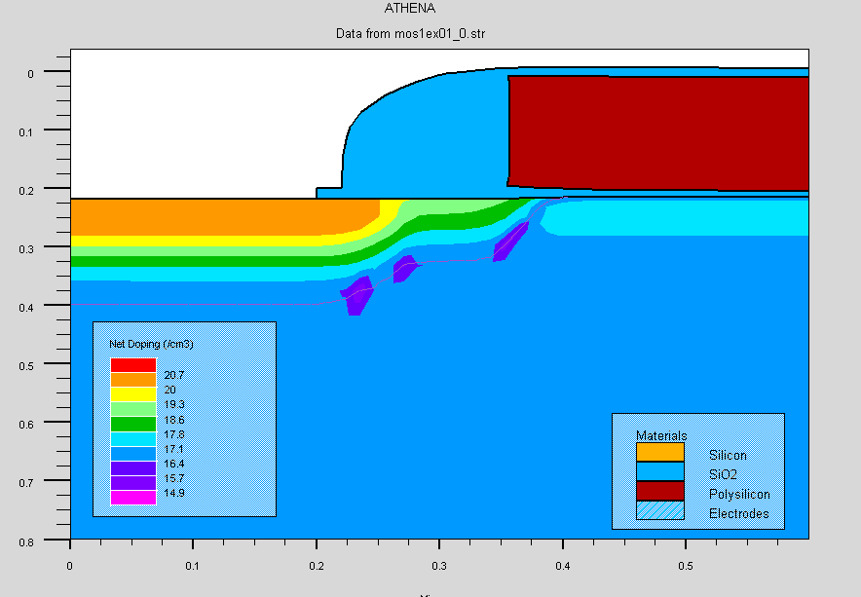
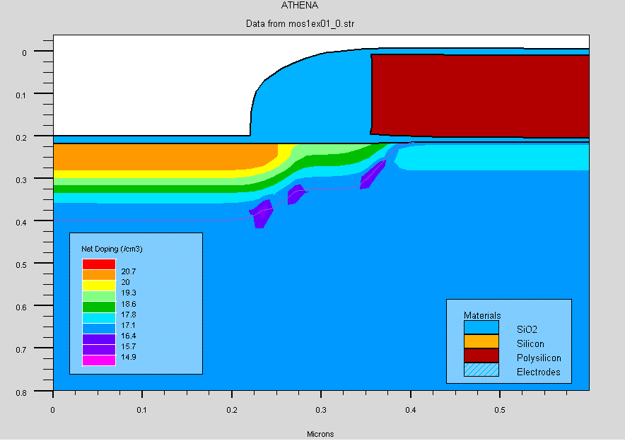
ARSENIC IMPLANTATION AND OXIDE ETCHING
implant arsenic dose=5.0e15 energy=50 pearson
#
method fermi compress
diffuse time=1 temp=900 nitro press=1.0
structure outf=structure_12.str
#
etch oxide left p1.x=0.2
structure outf=structure_13.str

Slide 20
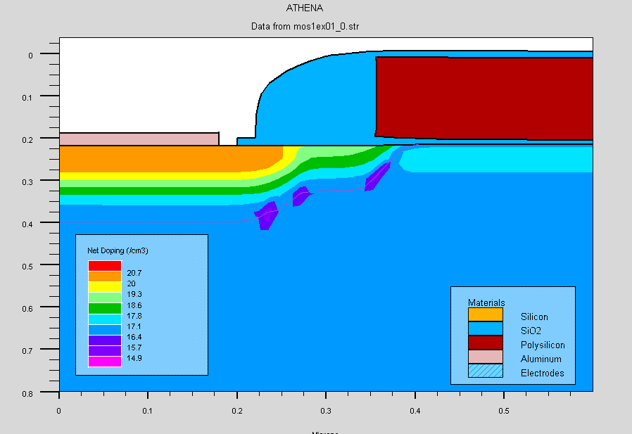
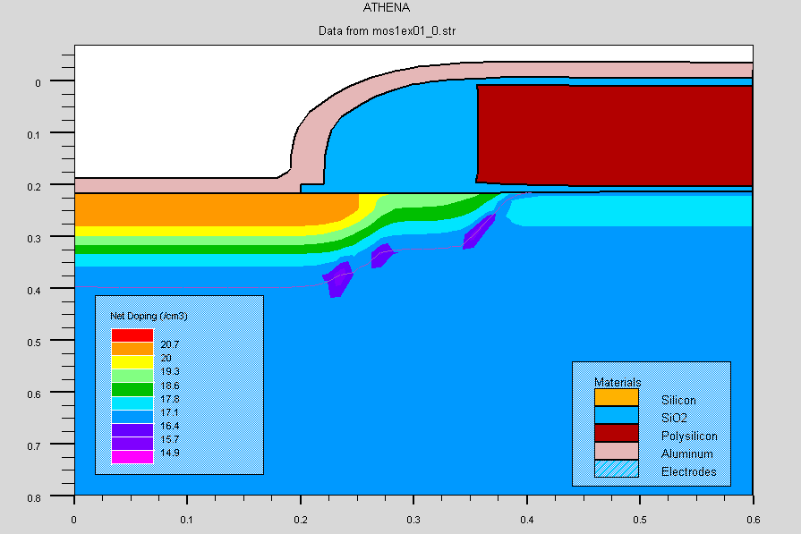
METAL DEPOSITION AND ETCHING
deposit alumin thick=0.03 divi=2
structure outf=structure_14.str
#
etch alumin right p1.x=0.18
structure outf=structure_15.str

Slide 21
EXTRACTION OF DEVICE DESIGN PARAMETERS
# extract final S/D Xj...
extract name="nxj" xj silicon mat.occno=1 x.val=0.1 junc.occno=1
# extract the long chan Vt...
extract name="n1dvt" 1dvt ntype vb=0.0 qss=1e10 x.val=0.49
# extract a curve of conductance versus bias....
extract start material="Polysilicon" mat.occno=1 \
bias=0.0 bias.step=0.2 bias.stop=2 x.val=0.45
extract done name="sheet cond v bias" curve(bias,1dn.conduct \
material="Silicon" mat.occno=1 region.occno=1) outfile="extract.dat”
# extract the N++ regions sheet resistance...
extract name="n++ sheet rho" sheet.res material="Silicon" mat.occno=1 \
x.val=0.05 region.occno=1

Slide 22
# extract the sheet rho under the spacer, of the LDD region...
extract name="ldd sheet rho" sheet.res material="Silicon" mat.occno=1 \
x.val=0.3 region.occno=1
# extract the surface conc under the channel....
extract name="chan surf conc" surf.conc impurity="Net Doping" \
material="Silicon" mat.occno=1 x.val=0.45

Slide 23
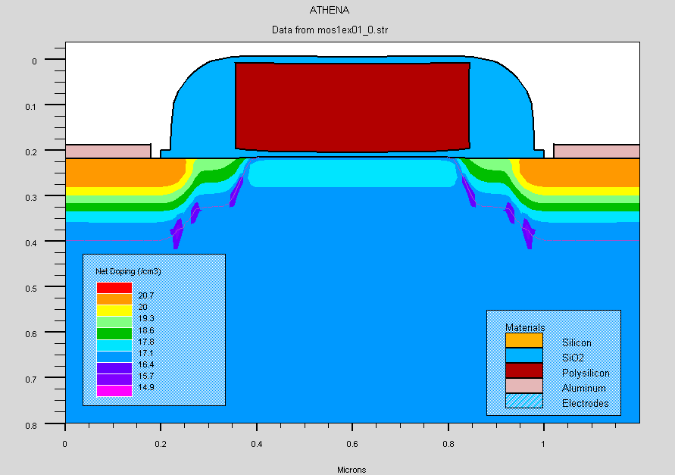
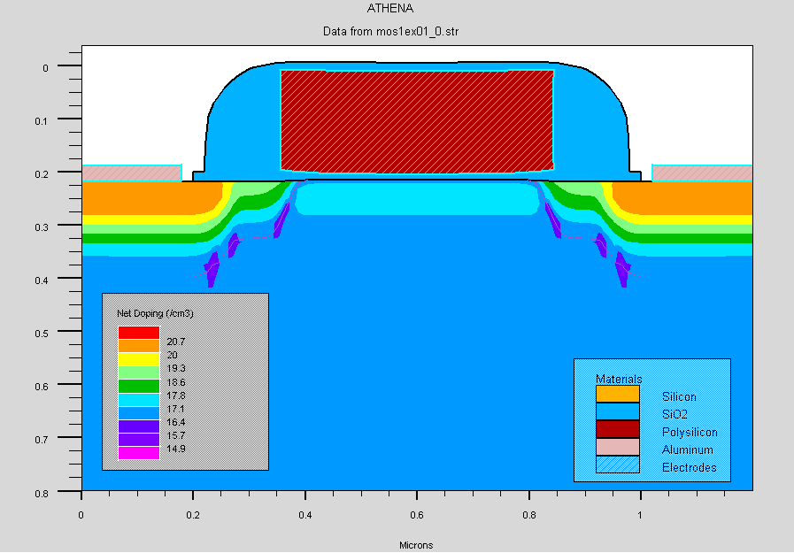
ELECTRODE SPECIFICATION AND MIRROR IMAGE STRUCTURE
structure mirror right
structure outfile=mos1ex01_0.str
electrode name=gate x=0.5 y=0.1
electrode name=source x=0.1
electrode name=drain x=0.9
electrode name=substrate backside
structure outfile=mos1ex02_0.str
# plot the structure
tonyplot -st mos1ex02_0.str -set mos1ex02_0.set

Slide 24
ELECTRICAL CHARACTERIZATION
go atlas
# set material models
models cvt srh print
contact name=gate n.poly
interface qf=3e10
method newton
solve init
# Bias the drain
solve vdrain=0.1
# Ramp the gate
log outf=mos1ex01_1.log master
solve vgate=0 vstep=0.25 vfinal=3.0 name=gate
save outf=mos1ex01_1.str

Slide 25
# plot results
tonyplot mos1ex01_1.log -set mos1ex01_1_log.set
# extract device parameters
extract name="nvt" (xintercept(maxslope(curve(abs(v."gate"),abs(i."drain")))) \
- abs(ave(v."drain"))/2.0)
extract name="nbeta" slope(maxslope(curve(abs(v."gate"),abs(i."drain")))) \
* (1.0/abs(ave(v."drain")))
extract name="ntheta" ((max(abs(v."drain")) * $"nbeta")/max(abs(i."drain"))) \
- (1.0 / (max(abs(v."gate")) - ($"nvt")))
quit

Slide 26
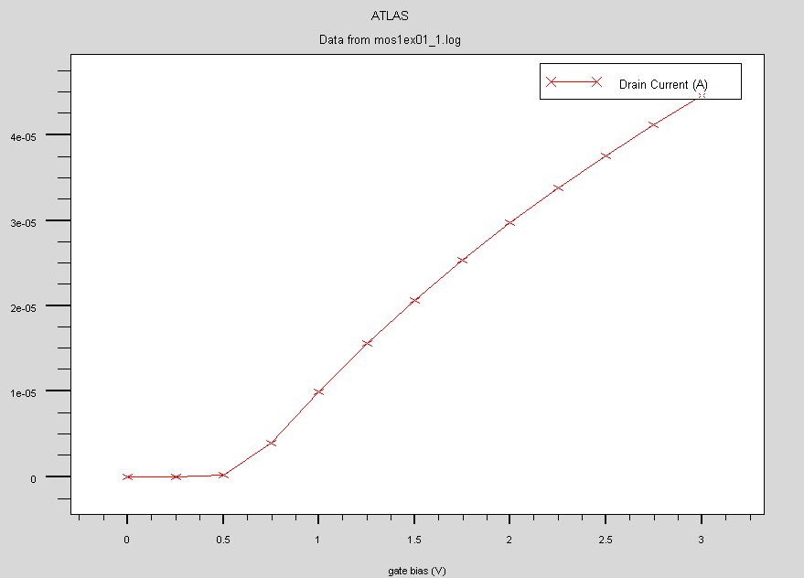

Slide 27
WORK DONE IN 7TH SEM
Study of process and device simulation basics with examples of SILVACO process simulator : ATHENA and device simulator: ATLAS
Design of N-MOS using ATHENA
Study of designed N-MOS electrical characteristics using ATLAS

Slide 28
WORK TO BE DONE IN 8TH SEM
Design of DRAM using trench capacitor
Optimization of the structure
Study of electrical characteristics of the designed DRAM varying various parameters

Slide 29
REFERENCES
Silvaco Manual

Slide 30
THANK YOU

